Slide 1

When a ‘Blue Check’ Means Nothing
Presented by Emily Escamilla
CS 895: Web Archiving Forensics
November 14, 2022

Slide 2
A Blue Check represents a verified account
“Verified” accounts were previously for
Journalists
Government officials
Celebrities
Help users know the validity of the account
Is that tweet from Taylor Swift or a fan page?
President Biden or a parody account?

Slide 3
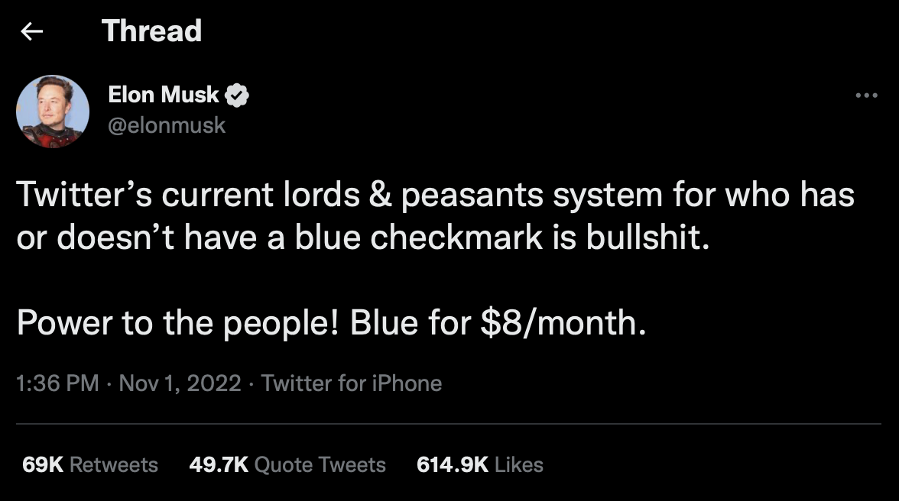
Nov. 1 Musk announced anyone can pay for a Blue Check
https://twitter.com/elonmusk/status/1587498907336118274

Slide 4
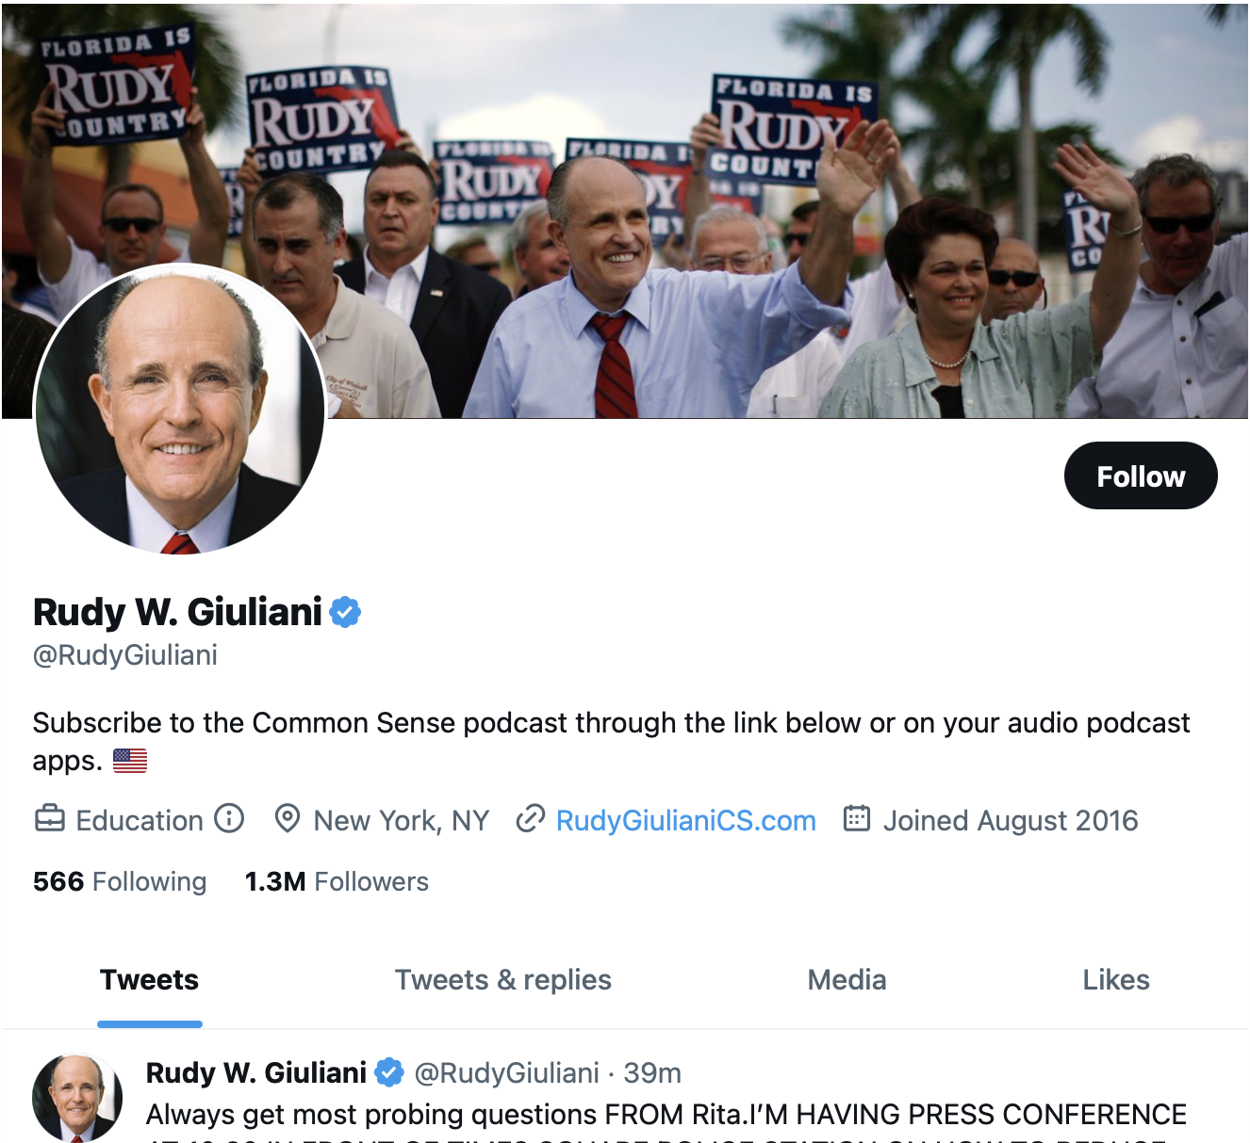
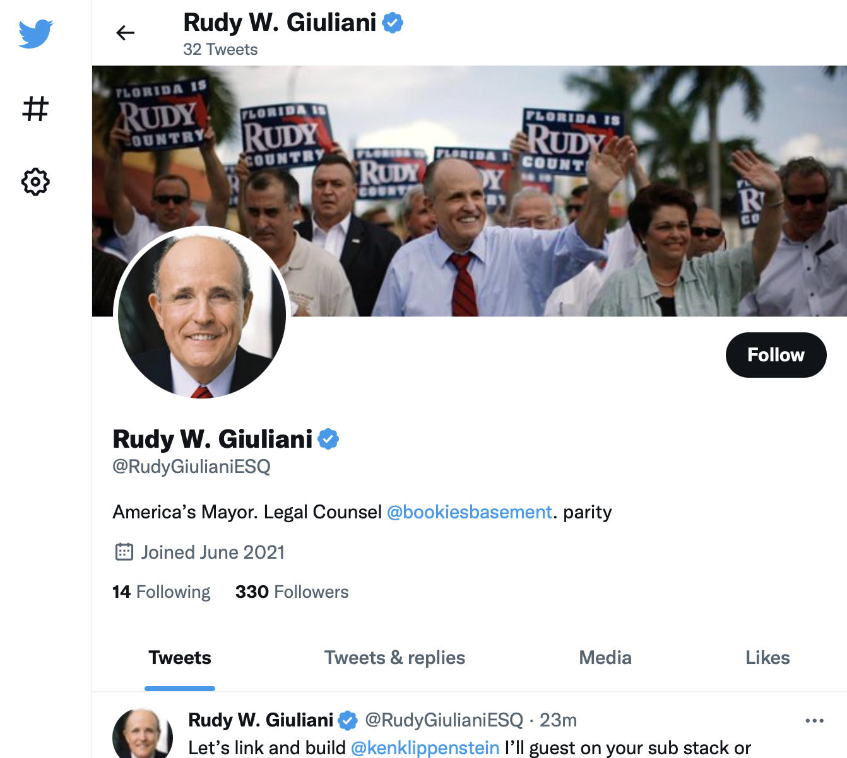
Using Rudy Giuliani as a Case Study
https://web.archive.org/web/20221105130721/twitter.com/rudygiuliani
https://archive.ph/RDnQO

Slide 5
Using Rudy Giuliani as a Case Study
https://web.archive.org/web/20221105130721/twitter.com/rudygiuliani
https://archive.ph/RDnQO

Slide 6
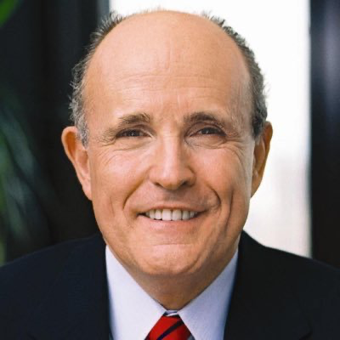
Who is Rudy Giuliani?
Former mayor of New York City
Vocal supporter of former President Trump
Over 1.3 million Twitter followers
Known to repeat conspiracy theories

Slide 7
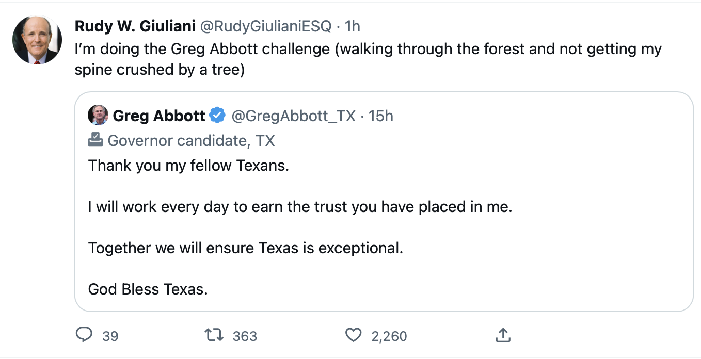
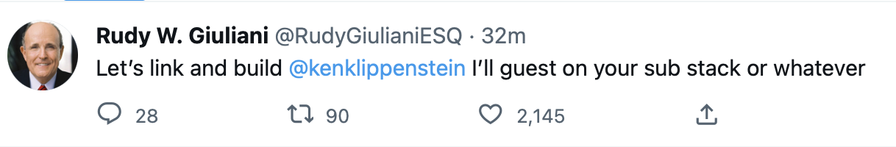
Some of the fake Tweets had high engagement
https://archive.ph/RDnQO

Slide 8
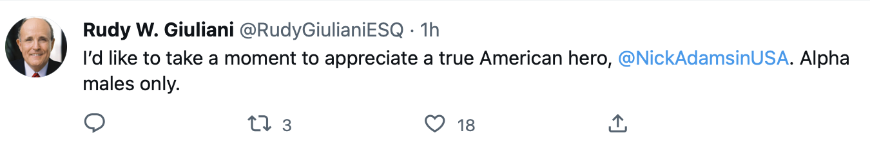
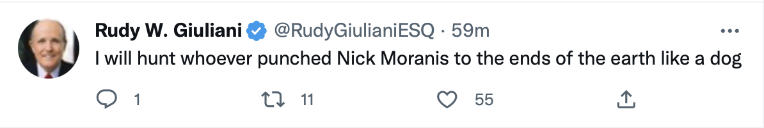
Some fake Tweets went unnoticed
https://archive.ph/RDnQO

Slide 9
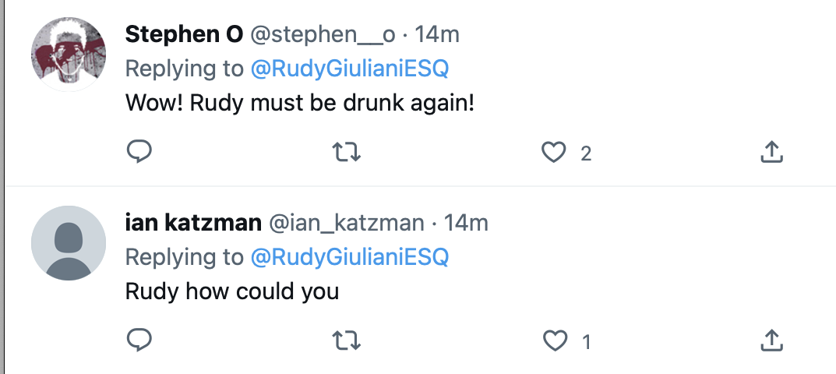
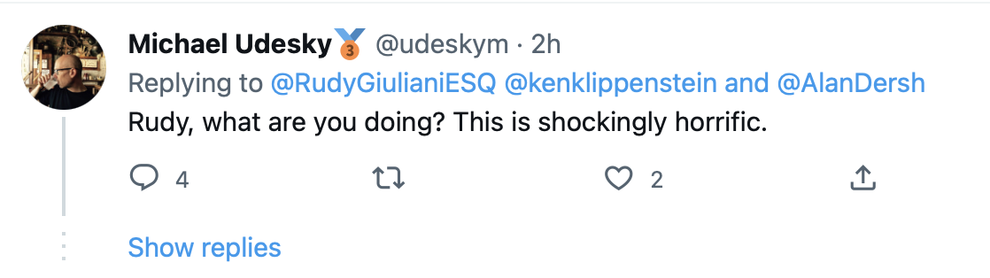
Not all users understood the Tweets as “parity”
https://web.archive.org/web/20221109225523/https://twitter.com/RudyGiulianiESQ/status/1590464105428946944
https://web.archive.org/web/20221109230509/https://twitter.com/RudyGiulianiESQ/status/1590458892089458688

Slide 10
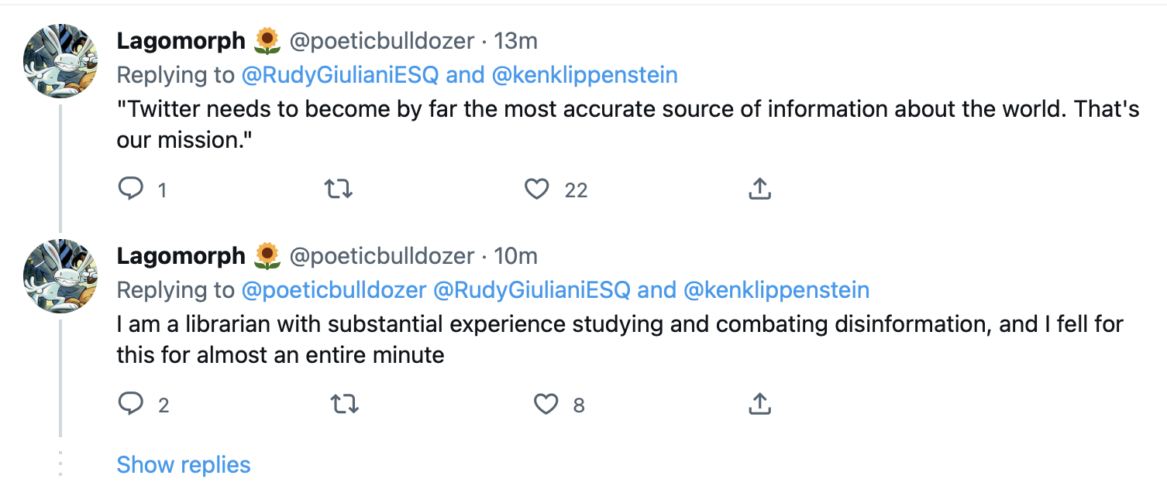
We’ve learned ‘Blue Check’ == Real
Quote from Elon Musk
https://web.archive.org/web/20221109225523/https://twitter.com/RudyGiulianiESQ/status/1590464105428946944

Slide 11
Save Page Now saved the day
27 Internet Archive captures via CDX
13 “Something when wrong”
4 reflected the suspension
10 working captures of the unsuspended account
All saved with “Save Page Now”
But can you spot what’s missing?

Slide 12
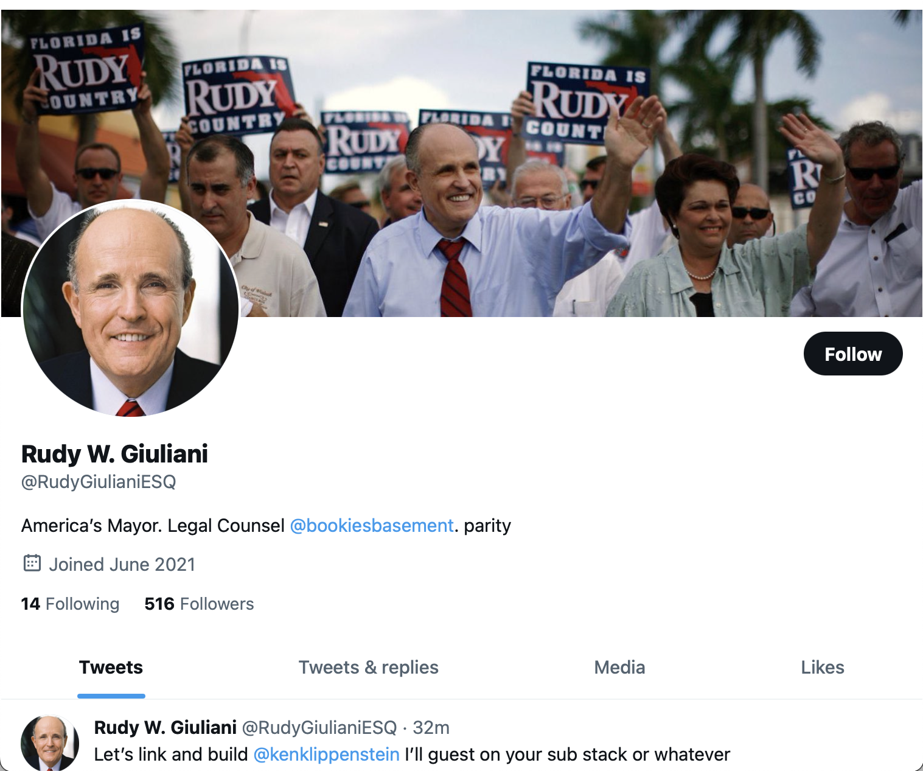
What’s missing from this verified account?
https://web.archive.org/web/20221109225523/https://twitter.com/RudyGiulianiESQ/status/1590464105428946944

Slide 13
IA didn’t capture the Blue Check
https://web.archive.org/web/20221109225523/https://twitter.com/RudyGiulianiESQ/status/1590464105428946944

Slide 14
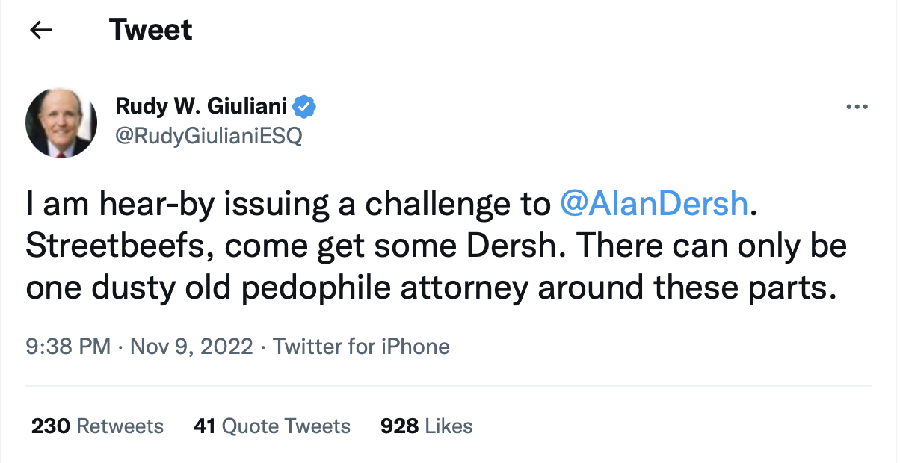
archive.today captured the Blue Check
2 minutes prior
https://archive.ph/imUc3

Slide 15
archive.today had the most complete captures
4 archive.today captures
1 reflected the suspension
3 reflected the live account
27 IA captures
13 soft-404s
14 functional captures

Slide 16
This is not an isolated event

Slide 17
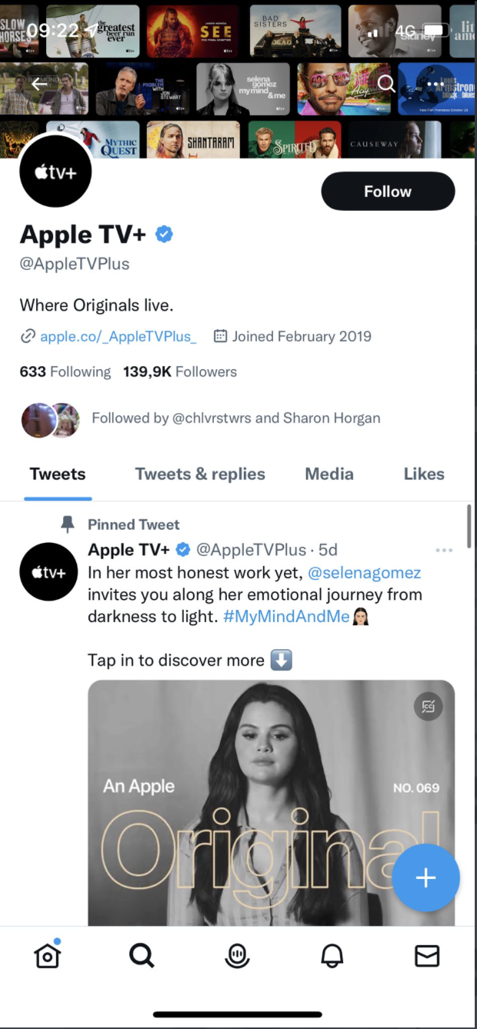
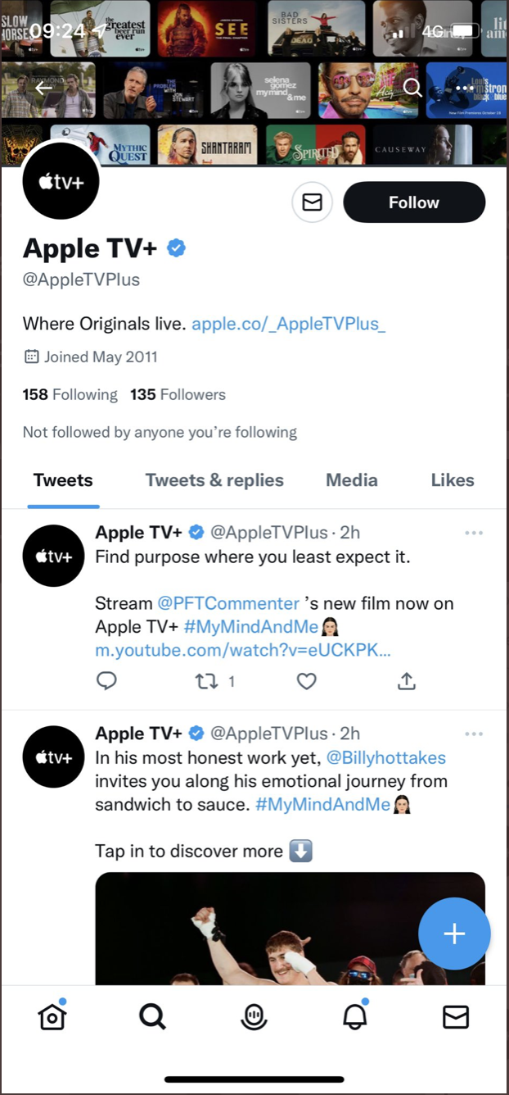
Spot the Difference: @AppleTVPlus
https://twitter.com/petefrasermusic/status/1590621763972780033

Slide 18
Spot the Difference: @AppleTVPlus
https://twitter.com/petefrasermusic/status/1590621763972780033

Slide 19
Spot the Difference: @AppleTVPlus
@AppleTVPlus
@AppIeTVPlus
https://twitter.com/petefrasermusic/status/1590621763972780033

Slide 20
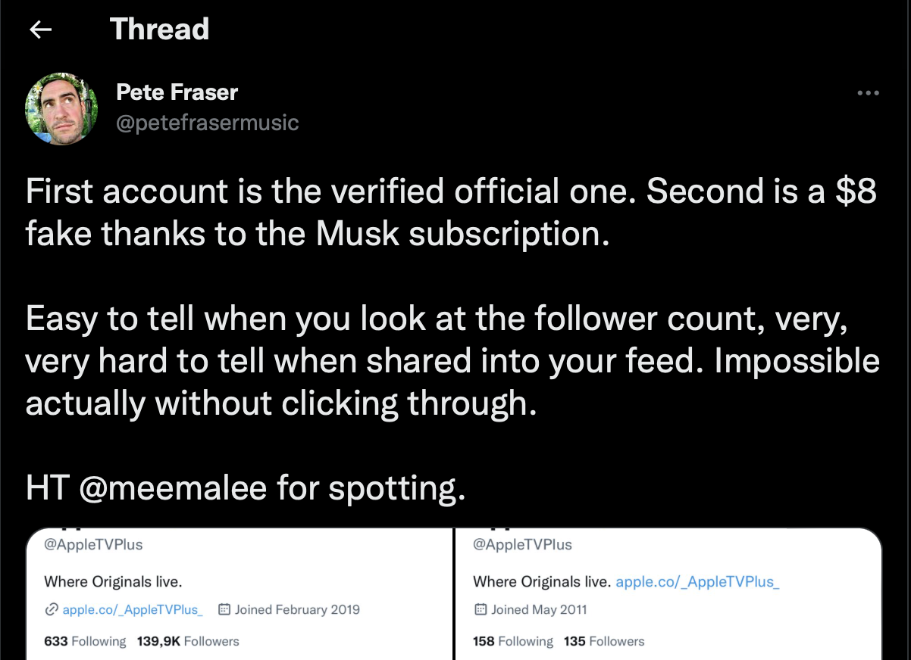
Spot the Difference: @AppleTVPlus
@AppleTVPlus
@AppIeTVPlus
https://twitter.com/petefrasermusic/status/1590621763972780033

Slide 21
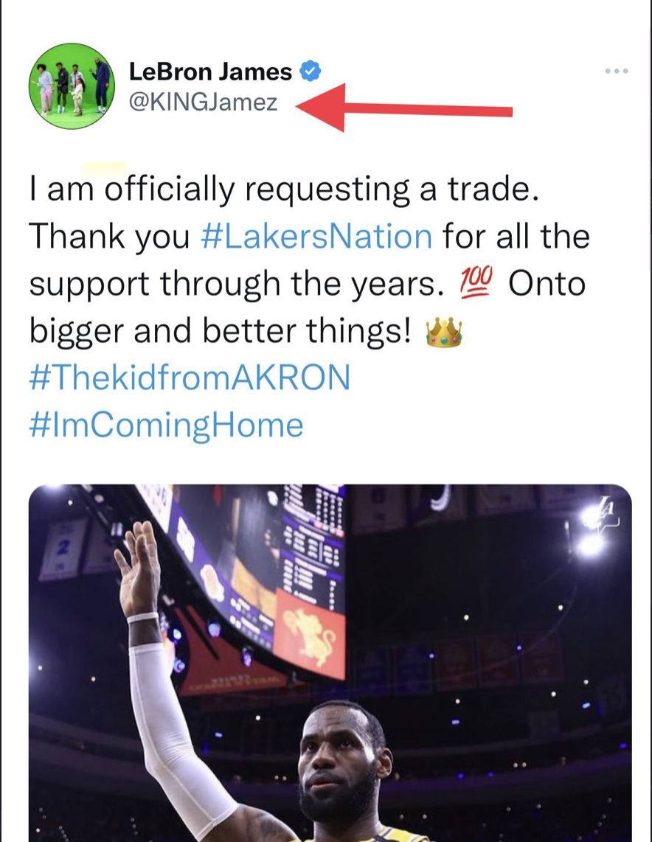
LeBron James wants a trade?
Real account is @KingJames
https://twitter.com/richer_frank/status/1590467627356651520

Slide 22
Big Ramifications

Slide 23
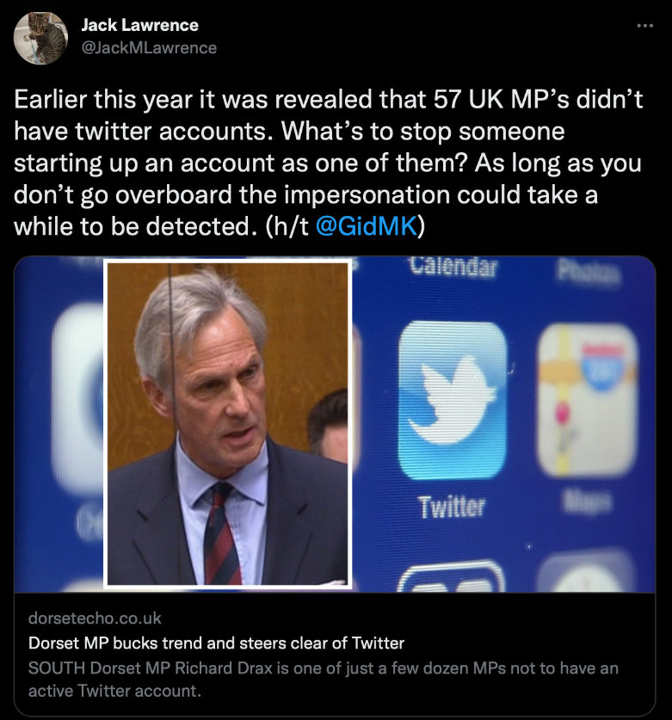
57 UK MPs don’t have Twitter accounts
Easy to impersonate a government official with no account
Blue Check adds validity to their tweets
https://twitter.com/JackMLawrence/status/1590509115394383872

Slide 24
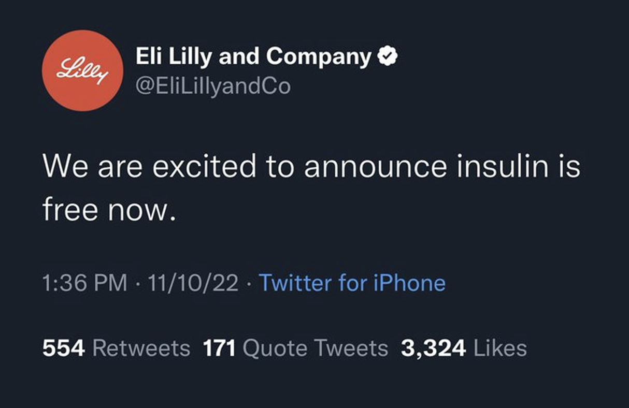
Eli Lilly and Co dropped 5.971% in 24 hours
$15B
Real account is @LillyPad
https://twitter.com/rafaelshimunov/status/1591133819918114816

Slide 25
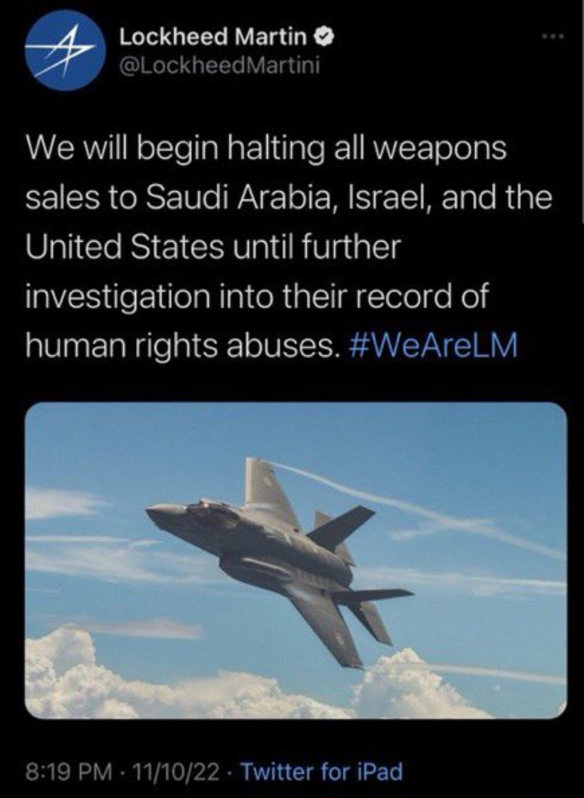
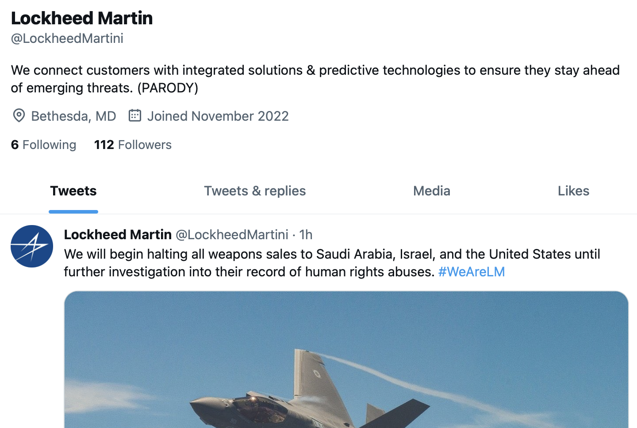
Lockheed Martin lost 5.51% in 24 hours
$6B
https://web.archive.org/web/20221111030313/https://twitter.com/LockheedMartini
https://twitter.com/litcapital/status/1591172069965713409

Slide 26
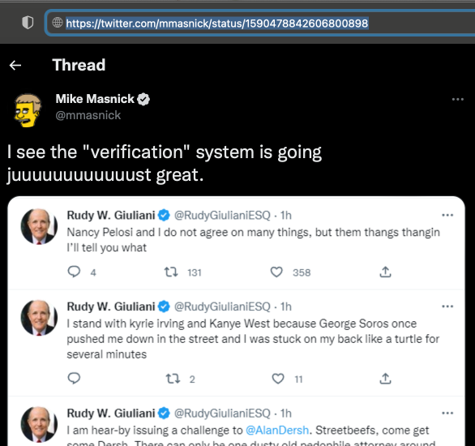
The presentation was inspired by @mmasnick
https://twitter.com/mmasnick/status/1590478842606800898

Slide 27
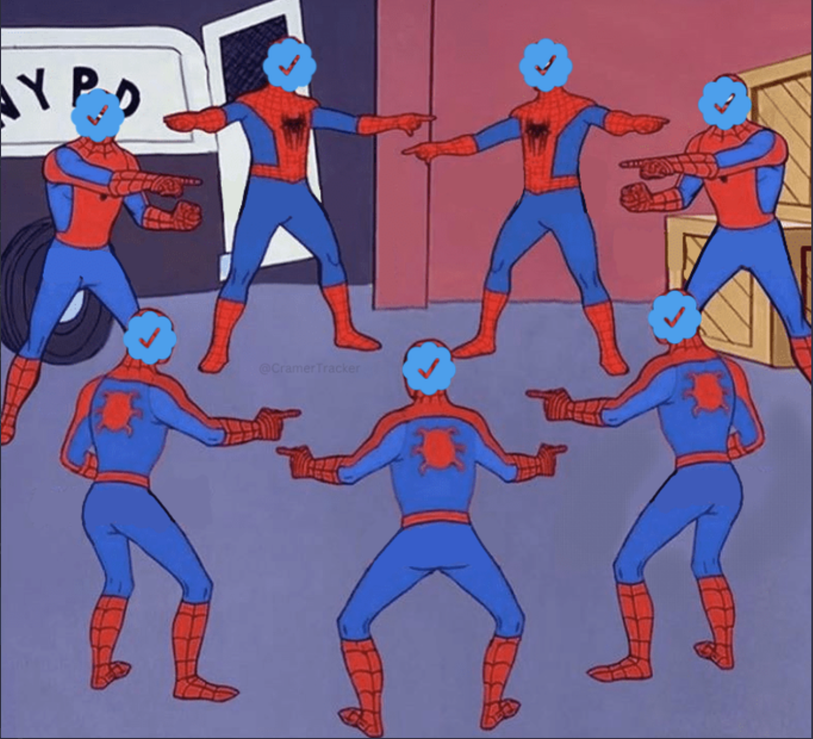
Key Takeaways
Surprised with the prevalence of “Something went wrong” captures
Save Page Now is vital for capturing “parody” accounts
With a good username choice, these accounts can go undetected
Can have huge political and financial ramifications
Current verification process is a playground for bad actors

